Slide 2
Overview of Tutorial
First two chapter of Study Guide
Chapter 1 : Number Systems
Chapter 2 : Set Theory and Binary Operations
Subject Matter for Tutorial
Selected end of chapter revision questions
Selected past paper questions
Also
Questions and Queries
We will open the discussion now, and continue at the forthcoming onsite tutorial

Slide 3
Chapter 1: Number Systems
Three main number systems
Decimal (i.e. 0,1,2,3,4,5,6,7,9)
Binary (i.e. 0,1)
Hexadecimal (i.e. 0,1)
Key Objectives
Converting from one number system to another.
Performing arithmetic operations (e.g. binary addition and subtraction)

Slide 4
The Binary System (1.1.2. pg 3)
Task: Converting decimal numbers to binary
“Express the decimal number (347)10 in base 2”
Taken from 2010 Zone A Examination paper – Q1c (2 Marks)
Worked Example on Next Slide
Correct Answer - 101011011
Make a note of correct answer. I have a question at the end of the working!

Slide 5
Decimal to Binary Conversion
 | Number | Divided by 2 | Quotient | Remainder
1 | 347 | 173.5
2
3
4
5
6
7
8
9
10

Slide 6
The Binary System (1.1.2. pg 3)
Task: Converting binary numbers to decimal
“Express the binary number (1011.011)2 as a decimal, showing all your workings.”
Taken from 2010 Zone A Examination paper – Q1b (2 Marks)
Worked Example on Next Slide
Important points
Anything to the power of zero is 1.
Demonstration of Negative Powers

Slide 7
Decimal to Binary Conversion
Number | Power of 2 | Component | Multiple
1 | 3 | 8
0 | 2 | 4
1 | 1 | 2
1 | 0 | 1
. | . | . | .
0 | -1 | 0.5
1 | -2 | 0.25
1 | -3 | 0.125
 |  | Total =

Slide 8
Binary Addition
Fundamental Operations
All digits below are binary
Two Basic Operations
0 + 0 = 0
1 + 0 = 1 also 0 + 1 = 1
Two More Advanced Operations
1 + 1 = 10 ( i.e. 0 carry the 1)
1 + 1+ 1 = 11 ( i.e. 1 carry the 1)
Task: carry out the following binary addition : 10101 + 11011
Taken from 2010 Zone A Q1a

Slide 9
Binary Addition ( part of 2010 Q1a)
1 | 0 | 1 | 0 | 1
1 | 1 | 0 | 1 | 1

Slide 10
Binary Subtraction
Use the concept of “borrowing”
Use basic operations from binary addition, but in reverse.
Important
10 - 1 = 1
Task: carry out the following binary addition : 110000 - 10111
Taken from Study guide Exercises Q5 pg 16
( Decimal Equivalent: 48-23)

Slide 11
Binary Subtraction
1 | 1 | 0 | 0 | 0 | 0
 | 1 | 0 | 1 | 1 | 1

Slide 12
Binary Multiplication
Follows on from Binary Addition
Additional Skill : Left Shifting
Task: carry out the following binary addition : 1101 x 1101
Taken from Study guide Exercises Q5 pg 16
( Decimal Equivalent: 13 x 13)

Slide 13
Binary Multiplication
 |  | 1 | 1 | 0 | 1
 |  | 1 | 1 | 0 | 1

Slide 14
Binary Division
Follows on from Binary Subtraction
Task: carry out the following binary division : 111011 ÷ 101
Taken from Study guide Exercises Q7 pg 17
( Decimal Equivalent: 59 ÷ 5)

Slide 15
Binary Division
1 | 1 | 1 | 0 | 1 | 1

Slide 16
Hexadecimal Conversion
Convert a Hexadecimal to Decimal
Hex | Dec | Hex | Dec | Hex | Dec | Hex | Dec
0 | 0 | 4 | 4 | 8 | 9 | C | 12
1 | 1 | 5 | 5 | 9 | 9 | D | 13
2 | 2 | 6 | 6 | A | 10 | E | 14
3 | 3 | 7 | 7 | B | 11 | F | 15

Slide 17
Hexadecimal Conversion
Task: Converting hexadecimal numbers to decimal
Convert the number (A5d)16 to decimal form (Answer : 2653)
Based on Question 10, page 17
(Recall - anything to the power of zero is 1)
A x 16 + 5 x 16 + D x 16

Slide 18
New Section: Set Theory and Binary Operations
Membership Tables
Venn Diagrams
Power Sets
Notation: Union “U” and Intersection “∩”
Relationship with Logical “AND” and “OR” in Chapter 3.
Complement of A is denoted “A/ ”

Slide 19
Set Theory and Binary Operations
Specifying Sets (2.1)
Listing Method
Rules of Inclusion

Slide 20
Set Theory and Binary Operations
Subsets (2.2)
Subsets and Proper Subsets
Cardinality of a Set
Power Set

Slide 21
Set Theory and Binary Operations

Slide 22
Membership Tables
A | B | C
0 | 0 | 0
0 | 0 | 1
0 | 1 | 0
0 | 1 | 1
1 | 0 | 0
1 | 0 | 1
1 | 1 | 0
1 | 1 | 1

Slide 23
Membership Tables : Set and Symmetric Difference
A | B | A – B | B - A | A ⊕ B
0 | 0
0 | 1
1 | 0
1 | 1
See Page 25 : Definitions 2.15 and 2.16

Slide 24
Venn Diagram / Blank Page

Slide 25
Membership Tables : Set and Symmetric Difference
A | B | C | A-B | B-A | B-C | (A-B)-C | A-(B-C)
0 | 0 | 0
0 | 0 | 1
0 | 1 | 0
0 | 1 | 1
1 | 0 | 0
1 | 0 | 1
1 | 1 | 0
1 | 1 | 1
See Page 31 Q 10 a

Slide 26
Venn Diagram / Blank Page

Slide 27
Venn Diagram / Blank Page

Slide 28
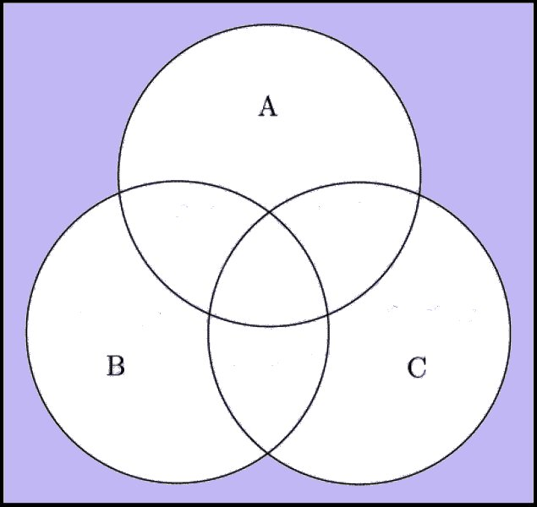
Venn Diagram / Blank Page

Slide 29
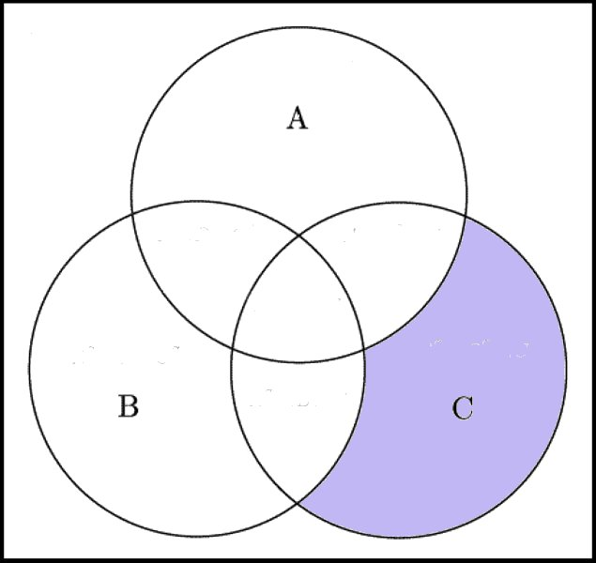
Venn Diagram

Slide 30
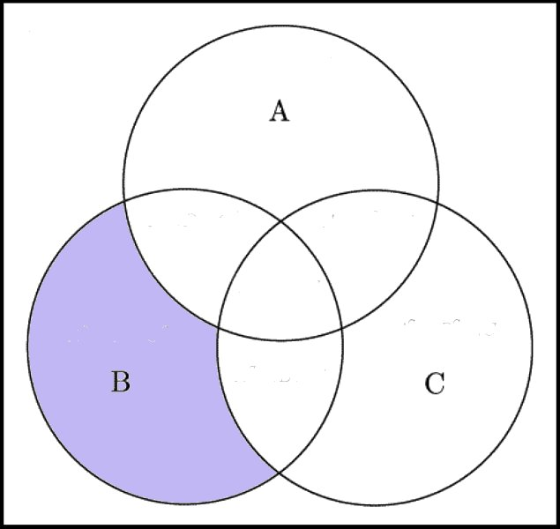
Venn Diagrams

Slide 31
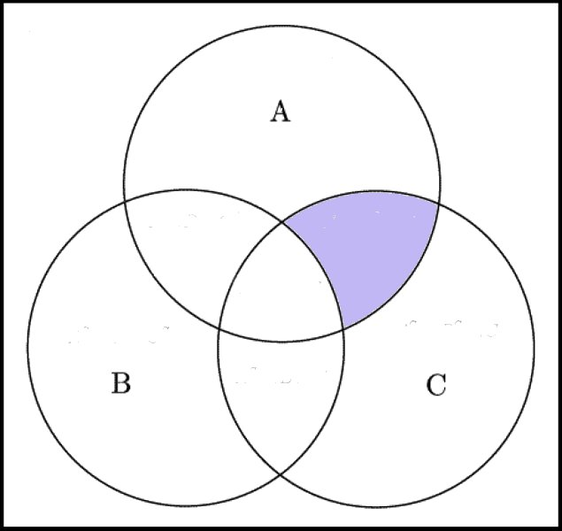
Venn Diagrams

Slide 32
Venn Diagrams

Slide 33
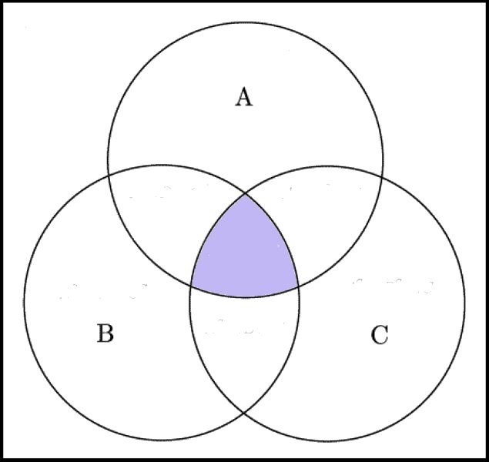
Venn Diagram

Slide 34
Venn Diagram / Blank Page

Slide 35
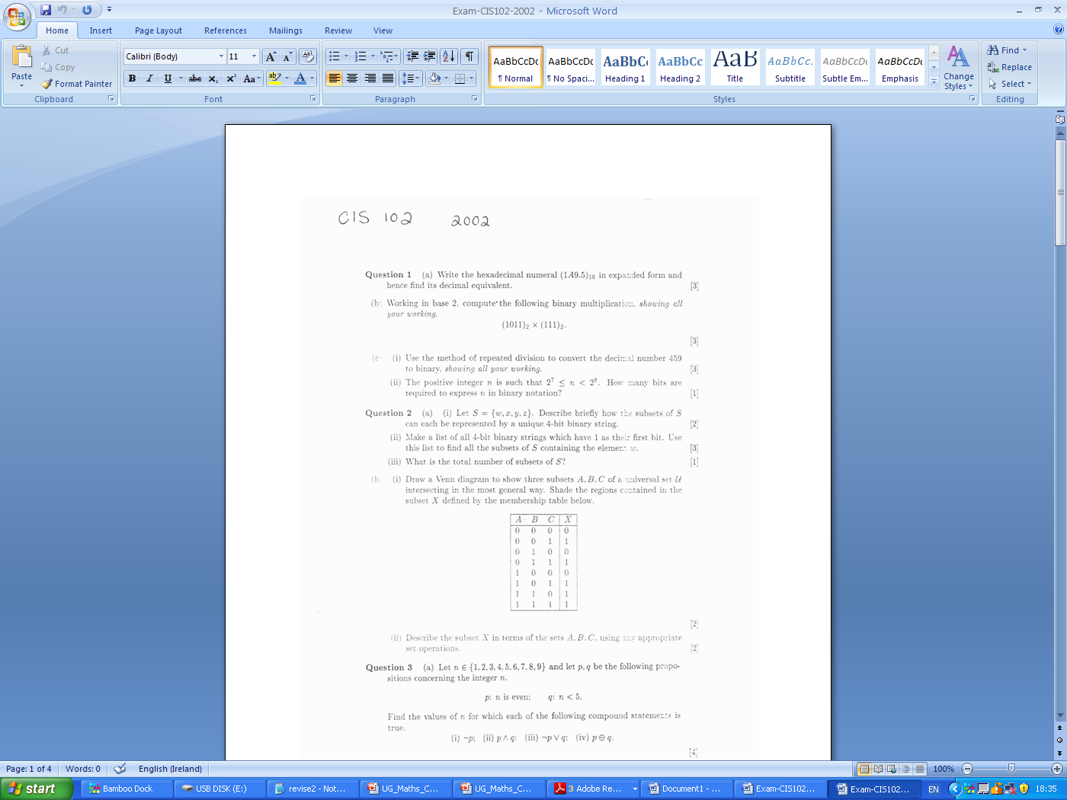
2002

Slide 36
2002

Slide 37
2002 - Blank

Slide 38
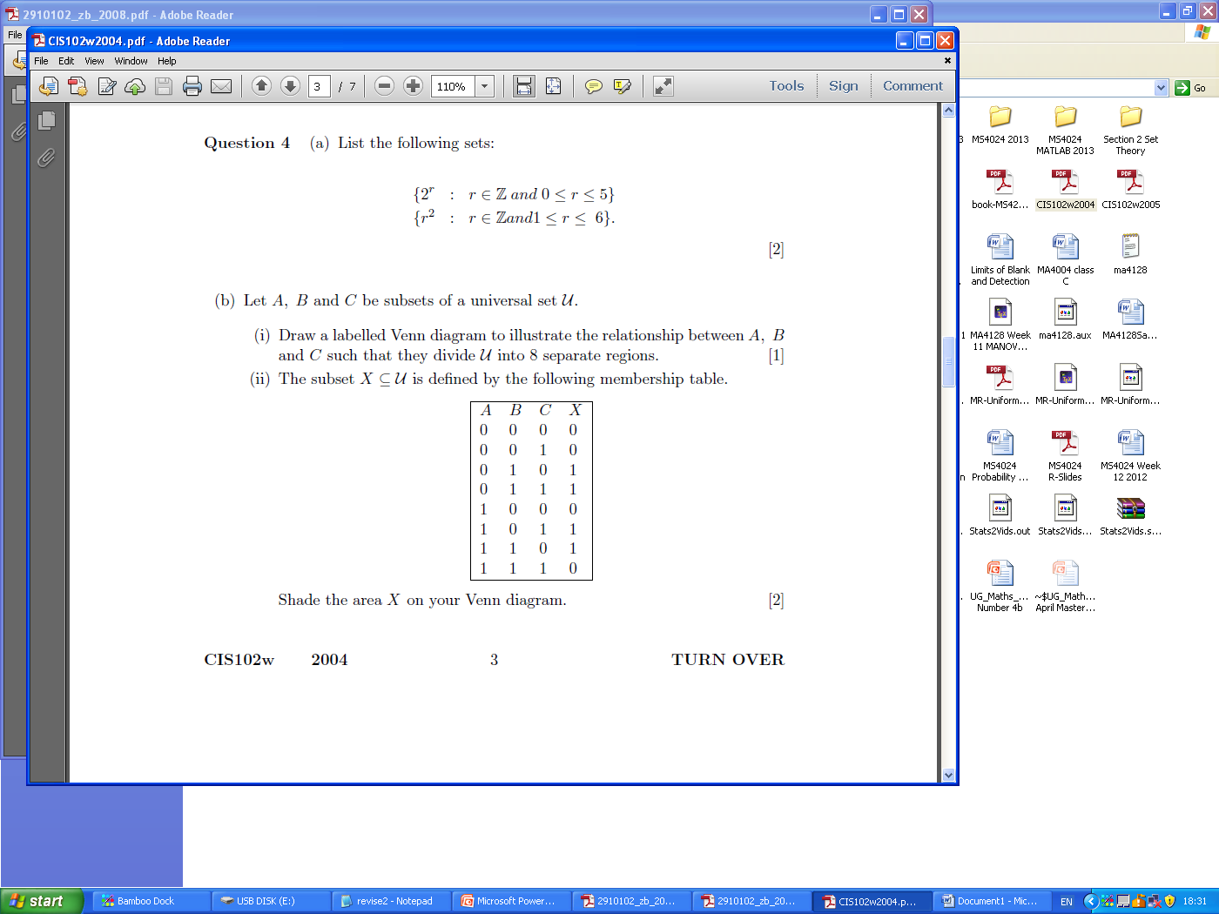
2004

Slide 39
2004

Slide 40
2004

Slide 41
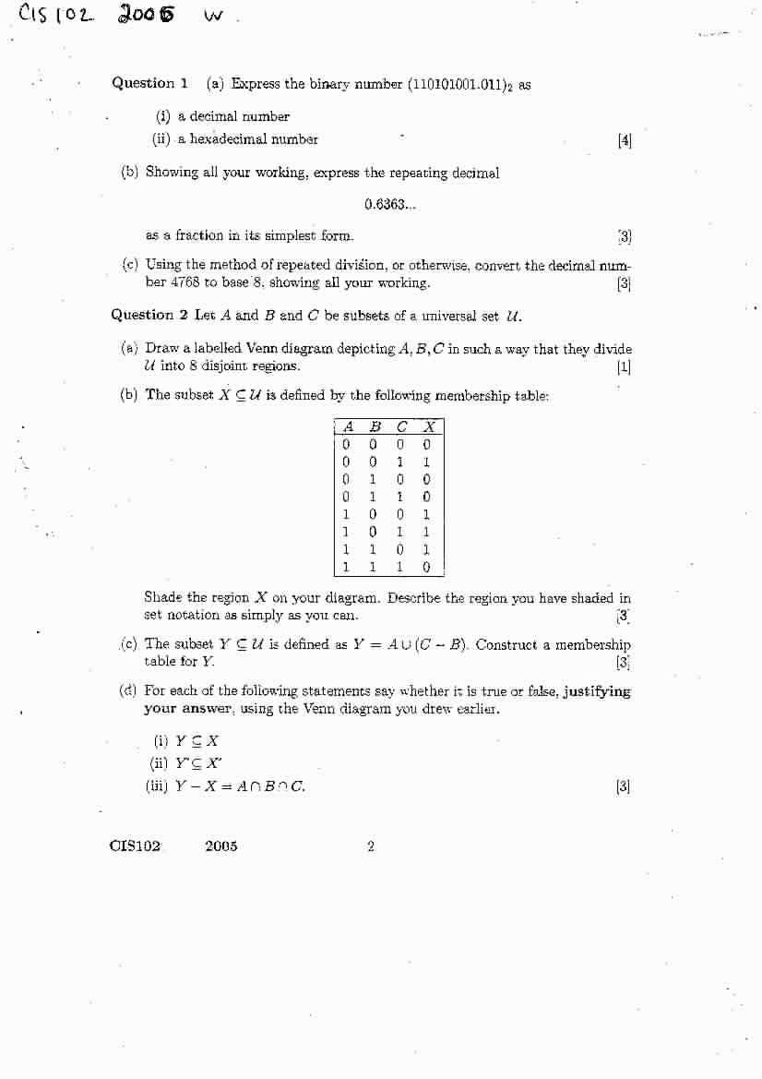
2005

Slide 42
2005

Slide 43
2005 - Blank

Slide 44
2005- Blank

Slide 45
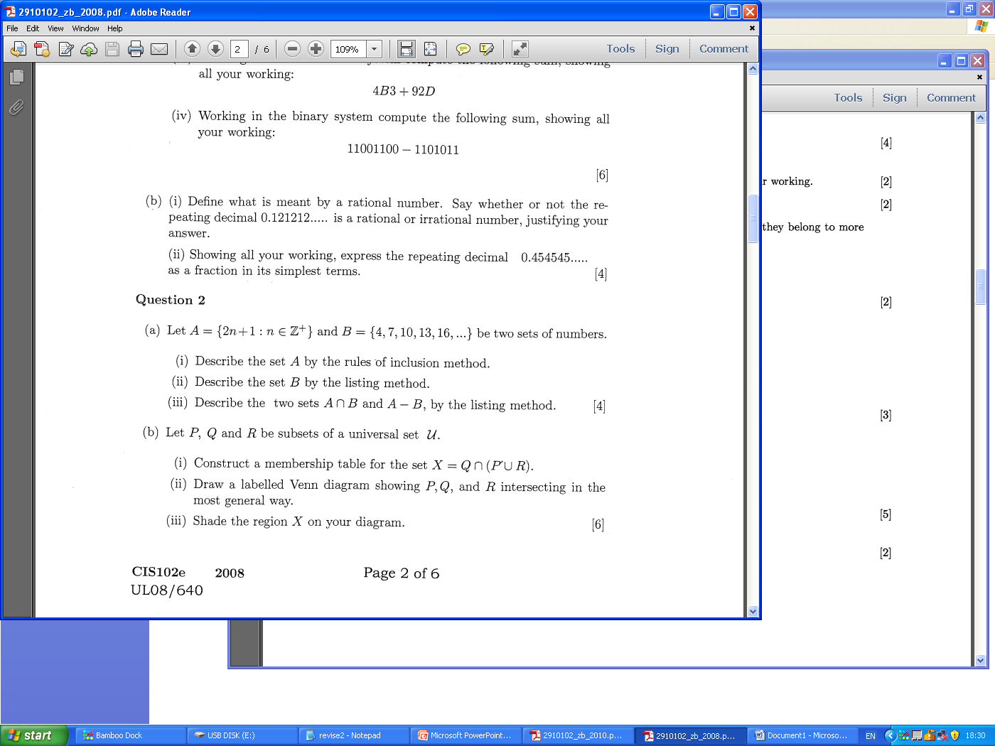
2008

Slide 46
2008

Slide 47
2008 - Blank

Slide 48
2008 - Blank

Slide 49
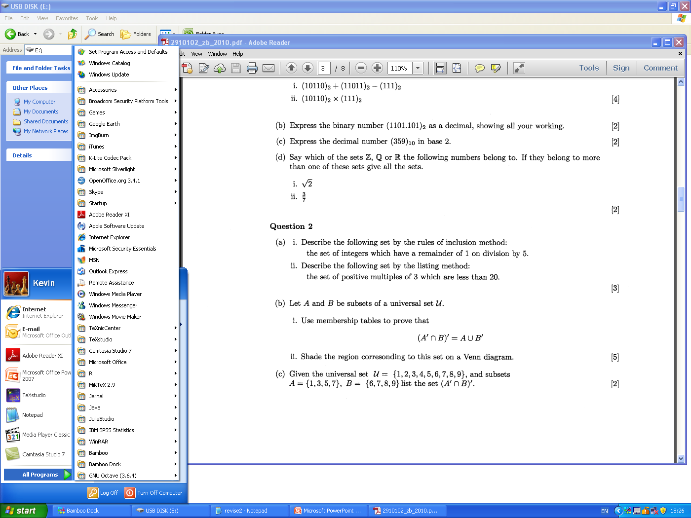
2010

Slide 50
2010

Slide 51
2010- blank

Slide 52
2010- blank

Slide 53
2010- blank

